Slide 1
Customer Engagement
Team of seven designers
5 UX | 2 UI specialist
Supporting two core product lines
Orchestration Center | Field Insights
Expanded product offering
FI Admin | GCC | Campaign Admin | Medical Science Liaison
4 new personas addressed
Growth from within
Agency model | Upskilling team-members
Has led to improved deliver: speed, quality, and collaborations
5,659 unique users monitored in Field Insights
supported by over 100 qualitative interviews
40 qualitative Orchestration Center end user interviews
Representing eight clients over the past three years
MSL research workshop
Senior leaders representing Medical Affairs, Medical Practice,
Digital Customer Engagement, and the ZAIDYN Platform
Internal research partnerships
ZAIDYN Product Marketing and ZAIDYN Knowledge Services

Slide 2
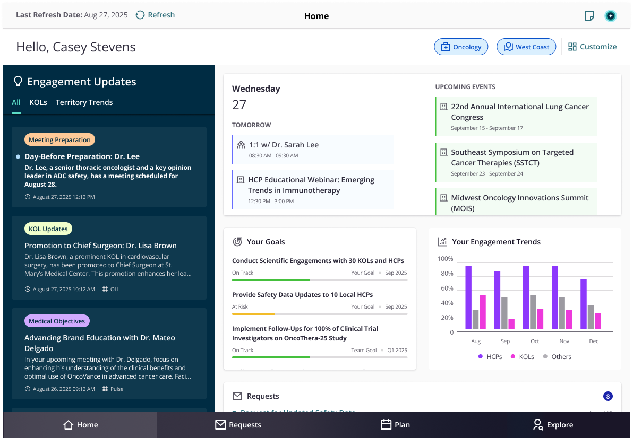
Medical Science Liaison product offering - MCE
"I think it has value. That's full stop. It definitely does.”
Working group consists of SMEs, Sponsors, PM, and Design
New business offering, grounded in persona storytelling, rather than starting with what was technically feasible
Alignment on the Why before the How
Prototype used to gain feedback from external advisors
MSL product focused on actionable intelligence scheduled to launch in Feb.
Design as an integral part of the strategy created a better business definition for what would be committed to in both the short & long-term visions
"It's a one stop shop, and if you can integrate all this stuff, this would be a real advancement in decreasing the MSLs administrative burden.”

Slide 3
CE Experience Challenges
Limits of flexibility Although advanced design work contributes meaningful value, it is sometimes subject to adjustments due to technical constraints or shifting priorities. A certain degree of change is expected and can be accommodated through agile practices; however, when changes become frequent or extensive, they may introduce added complexity. This can lead to ongoing efforts to maintain alignment between products and demos and may pose challenges in sustaining user confidence.
Legacy infrastructure to agentic workflows Continued support for earlier versions of the product remains an area of ongoing attention across both technical and experience domains. This complexity is expected to increase as newer agentic workflows are introduced.
Proxy v. End User A strong reliance on proxies for workflow and usability feedback has sometimes constrained the evolution of features beyond their initial launch. Over time, assumptions -whether informed or not - about user goals and outcomes tend to give way to a greater emphasis on product engagement features.
Addressing these could
Decrease cost
Through a reduction of product debt, stable delivery forecasting, and strong position within client relationships
Increase simplicity By means of natural product migration as it matures, more impactful technology enhancements, while reducing maintenance support
Improved selling
As a result of more impactful demos and product marketing content, market shifts, and agentic workflow storytelling

Slide 4
Customer Engagement
5,659 unique users monitored in FIA
supported by over 100 qualitative interviews
40 qualitative OC end user interviews
Representing eight clients over the past three years
Onsite MSL research workshop held January 2025
senior leaders representing Medical Affairs, Medical Practice,
Digital Customer Engagement, and the ZAIDYN Platform
Internal research partnerships
ZAIDYN Product Marketing and Knowledge Services

Slide 5
Highly collaborative
Field Insights
Key Finding The field is more collaborative than first realized Main Takeaway Tracking individual rep’s sales activity is not enough to provide full value HMW Enable seamless team collaborations towards the HCP goal?
I found overlap with my sales partner’s email send outs, but it takes a few clicks to check email history through Veeva CRM... we would have sent to the same people on the same day if I didn’t check what had already gone out.
Normally every Thursday, over Teams or over the phone, we're both looking at the app to go through and decide who we’ll see every week. We’ve developed this method to collaborate... but it would be lovely to have this on [one] page.
When we do a team [training] session, first thing we do, I say “let me see your iPad,” then I'm going through it myself and saying, “who are we gonna go see today?”
Lilly
Territory
Manager
ViiV
Territory
Account
Manager
UCB
District
Manager
Notes:
Sales teams are highly collaborative
Tracking individual rep’s sales activity is not enough to provide full value. Design updates created opportunities for collaboration by making rep actions – visits, calls,email – visible across sales teams
I found overlap with my sales partner’s email send outs, but it takes a few clicks to check email history through Veeva CRM... we would have sent to the same peopleon the same day if I didn’t check what had already gone out - Lilly Territory Manager
Normally every Thursday, over teams or over the phone, we're both looking at the app to go through and decide who we’ll see every week. We’ve developed thismethod to collaborate... but it would be lovely to have this on (one) page. – ViiV Territory Account Manager
When we do a team (training) session, first thing we do, I say “let me see your iPad,” then I'm going through it myself and saying, “who are we gonna go see today?” -UCB District Manager

Slide 6
Aligning with GCC market needs while cutting costs
Orchestration Center
It's actually confusing. We get some kind of error, like there was suggestion ID and then there's some random text. It's very difficult for us to get the idea why this error is shown. So, for that, we tend to follow up with the support team.
Bristol Myers Squibb
Regular product feedback enabled OC enhancements to be prioritized along with new features and workflows that expanded the product towards a GCC epicenter.
The results being timely product improvements that cut overhead costs [support tickets] and better align with shifting market needs of our customers, particularly those aligned with GCC user workflows.

Slide 7

Expanding our offering
MSL
By addressing a rising personas, research found areas for product expansion that will help Medical Science Liaisons become more integrated into the HCP ecosystem
Notes:
By addressing untapped personas, we’ve found areas for product expansion that will help MSLs become more integrated into HCP ecosystem
Our new MSL product offering is unique: No existing solution centralizes internal and external data for MSLs and acts as a “system of intelligence” today
"it's a one stop shop, and if you can integrate all this stuff, this would be a real advancement in decreasing the MSLs administrative burden."
"I think it has value. That's full stop. It definitely does."
"I love the layout. It's very simple and intuitive."
"The CRM typically has only things that are in the CRM itself... It doesn't often show you one system for everything you do, many companies haven't integrated in: this person requested a grant, this person was an author for this, this person was at this ad board for us, this person with an investigator those systems - having that customer master across all those are not often in place within companies."

Slide 8
No existing solution centralizes internal and external data for MSLs and acts as a “system of intelligence” today
MSL
Advisor reactions
"It's a one stop shop, and if you can integrate all this stuff, this would be a real advancement in decreasing the MSLs administrative burden.”
"I think it has value. That's full stop. It definitely does.”
"I love the layout. It's very simple and intuitive.”
"One of the tool’s standout features is its ability to display the KOL’s past engagement history. The CRM typically… doesn't show you one system for everything you do - this person requested a grant, this person was an author for this, this person was at this ad board for us, etc. Having that customer 'master' across all those [activities] is not often in place within companies."

